Slide 1

Progress Review and Testing Overview
SEP Team 5

Slide 2
Progress Review

Slide 3
MVP Progress Review
MVP:
Catalog view of monsters, player characters, encounters, and campaigns
CRUD for monsters, player characters, encounters, and campaigns
Basic running through an encounter of a campaign
Left to Do and Scheduling Plan:
UD Front end integration for Encounters and Campaigns [U - Sprint 5, D - Sprint 6]
CRUD integration for player characters [Sprint 6]
Catalog view of player characters [Sprint 6]
Basic running through an encounter [4/7 tasks for Sprint 5, remaining 3 tasks for Sprint 6]

Slide 4
Testing Overview

Slide 5





Testing Tools
TS-Enzyme:
React Integration
Front End Testing
TS-Jest:
API Testing Integration
Backend and Scripting Testing
Travis CI and CodeCov:
Continuous Integration
Ensures 80%+ code coverage on all pull requests
Nock:
Mocks HTTP requests and their returns
Notes:
Enzyme JS (React & Front End)
Jest (API and Scripting)
Travis CI (CI, ensuring tests are run)

Slide 6



Testing Responsibilities
Feature developer(s) are responsible for implementing all code-based tests for their feature
Code reviewer are responsible for verifying that the code-based tests are accurate and comprehensive for the feature
Product owner is responsible for (official) acceptance testing

Slide 7
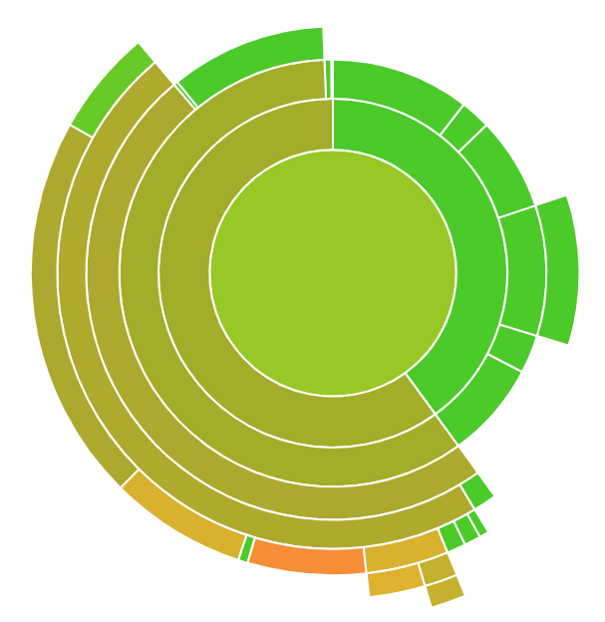
Testing Standards (Unit & Regression Testing)
Unit Testing
At least 80% of all feature code has to be covered
Usually close to 90%, with a few 80%’s
Regression Testing
At least 80% of codebase must be covered at all times
Consistently has been around 93%
100% of the tests for the codebase must pass at all times
V 100%
80% ^
Notes:
Yusuf
We are employing a comprehensive testing workflow in this project.
Every implemented feature will have unit tests to check functionality.
We use Red-Green-Refactor approach when implementing a new feature. Basically, we first write the test, then implement the minimum software to pass the test, and then evaluate and refactor the code for edge cases.
Every developer is responsible to write the unit tests for corresponding feature and choose appropriate reviewers.
Overall, we are requiring an at least 80% code coverage for the whole application.
In addition to unit tests, we will also have integration tests that will test the interactions between different features.

Slide 8
Testing Standards (Acceptance Testing)
External Product Owner pilots feature to local DMs currently involved in campaigns
Piloting observed by scrum master and reported back to team
All features must be accepted by the external product owner and (within reason) local DMs
Procedure for conflict between DMs and team/product owner documented on Wiki

Slide 9
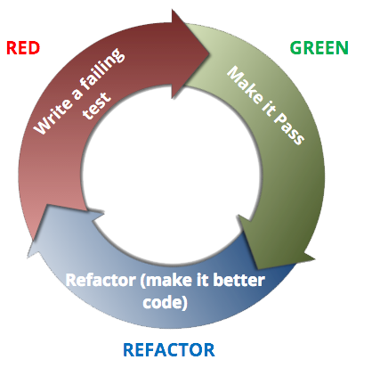
Testing Implementation Strategy
Snapshot Testing
Happy/Sad Path Testing
Pseudo-Red-Green Refactor
Isolate Components and Interactions via Mocking when not implementing integration testing
Notes:
Yusuf

Slide 10
Product Demo

Slide 11
Questions? Comments? Concerns?

